Slide 1
Software Systems Engineering
DEEPER ANALYSIS

Slide 2
engineering, like systems engineering itself, is both a technical and management process. The technical process of SwSE is the analytical effort necessary to transform an operational need into a description of a software system; a software design of the proper size, configuration, and quality; its successive elaboration in requirements and design specifications; the procedures needed to verify, test, and accept the finished product; and the documentation necessary to use, operate, and maintain the system.

Slide 3
Role of Software in Modern Systems
The dominant technology in many modern technical products is software. Software often provides the cohesiveness, control, and functionality that enable products to deliver solutions to customers
Software also provides the flexibility needed to work around limitations or problems encountered when integrating other items into the system.
This is especially true for problems discovered late in the development cycle, such as in integration.

Slide 4
In the air traffic control system, for example, software integrates people, radar, airplanes, communications, and other equipment to provide an effective air traffic control system.
Software also provides the functionality needed to integrate modern business in the form of enterprise information systems or enterprise resource planning systems, as well as supporting the creation of virtual communities and interest groups on the Internet

Slide 5
Application of Systems Engineering to Software Systems
systems engineering defines the product at the highest level. The systems engineering approach focuses on the operation and use of the product throughout its life cycle and applies this viewpoint to the specification of the essential features that all solutions to the problem should possess.

Slide 6
This is done prior to decomposing the solution into specific hardware and software subsystems. Applying this same philosophy to software subsystems, or to systems composed purely of software, results in the description of the software in terms of its essential features and how those features relate to the use and operation of the system throughout its life cycle.

Slide 7
The Necessity of Software Systems Engineering
The rate at which new, complex products are being developed is continuously accelerating, and the proper operation of many of these new systems is highly dependent on software systems and subsystems. Thus, software systems are larger and more complex now than at any time in history. This trend is caused by a number of factors, acting separately and
together:

Slide 8
Inexpensive computer hardware is available, which allows users to specify more sophisticated and complex requirements.
• Software is providing an ever-increasing percentage of many systems' functionality.
• Increased software complexity is driven by increased system complexity,
• Customers are demanding more reliable and usable software systems
Customers want the flexibility offered by software-based solutions.

Slide 9
As software projects grow in size and complexity, so does the risk that problems will occur. Such large and complex systems require the technical system management provided by the systems engineering approach. Without such a systems engineering approach the following problems often result:

Slide 10
Complex software systems development projects become unmanageable.
Costs are overrun and schedules are missed.
Unacceptable risks are not recognized and, as a result, the project takes the risk unknowingly.
Unacceptable engineering procedures (or none at all) are used

Slide 11
5. Erroneous decisions are made early in the life cycle that are often not detected until late in the project when they are very costly to correct
Subsystems and components are developed without proper coordination. The result is that they will not integrate readily—or at all.
Some parts and components are never specified or built. Requirements, even if captured in the software requirements specification, are ignored and, as a result, not met.
The delivered system fails to work properly. Parts of the system must be reworked after delivery— repeatedly

Slide 12
Role of Software Systems Engineering
For software only projects, the software systems engineering function is responsible for the overall technical management of the system and the verification of the final products.

Slide 13
Interface technically with the customer.
Support systems engineering at the product level for hybrid hardware/software systems.
Determine project software effort and schedule.
Determine and manage software technical risk.
Define and document software requirements.
Perform functional analysis of requirements
Determine system data throughput and storage.
Perform trade-off studies and time-line analyses.
Develop prototypes

Slide 14
Relationship to Software Engineering
Some areas of overlap are seen with the preceding discussion of software systems engineering and the activities of software engineering as usually conceived.
Significant differences do, however, exist. In particular, as usually defined, software engineering is principally concerned with the implementation of software requirements.
THE FIGURE BELOW SHOWS the relationships between systems engineering, software systems
engineering, and software engineering functions

Slide 15
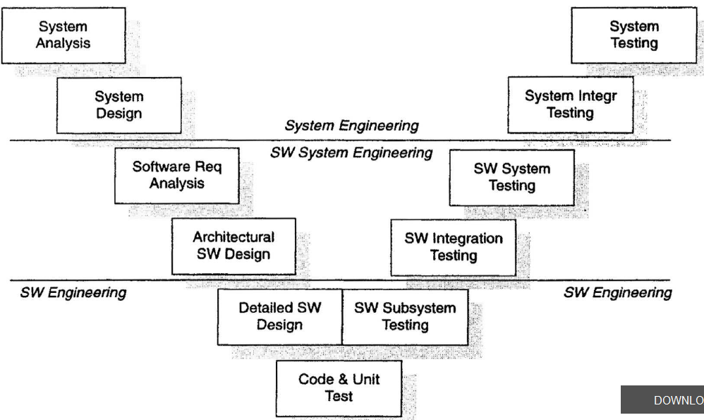

Slide 16
In this view, the systems engineering function performs initial analysis and design and final system integration and testing.
During the initial stages of software development, the software systems engineering function is responsible for software requirements analysis and architectural design.
Software systems engineering is also responsible for the final testing of the software system and its delivery to the systems function. Actual component engineering, implementation, and testing are the dominion of software engineering in this view.

Slide 17
Requirements analysis (problem definition)—Determine the needs and constraints by analyzing the system requirements that have been allocated to software.

Slide 18
Architectural software design (solution analysis)—Determine the set of solutions to the software requirements and constraints, conduct trade studies, perform analysis of possible solutions, and select the optimum one.
• Process planning—Determine the tasks to be done, the scope and the effort necessary to perform the tasks, the precedence between tasks, and the potential risks to the project.

Slide 19
Process control—Determine the methods to be used in technically controlling the project and the processes, measure progress, review intermediate products, and take corrective action when necessary.
Verification, validation, and testing (product evaluation)— Evaluate the final product and documentation through testing, demonstrations, analysis, and inspections. This includes any necessary software system integration activities

